Slide 1
Smart Cat Flap

Slide 2
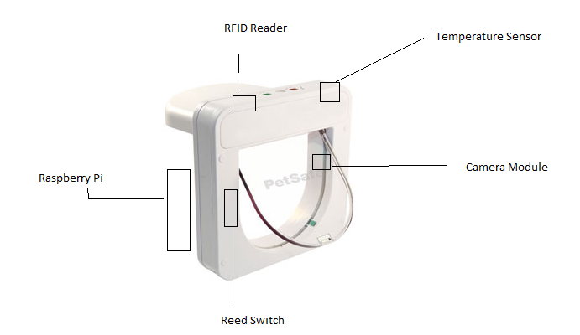

Slide 3
Devices to be used:
DS18B20 temperature sensor,
Camera module,
RFID reader,
Raspberry Pi Rev 2 board.

Slide 4
Basic idea and working
Every cat has RFID chip inside them, when the cat pokes its nose near to the cat flap the flap will open for that particular cat whose RFID number is matched with the database.
We will use camera module to catch the picture of cat while entering and it will store inside the database so that we can see that which other cats are trying to get inside the house and we can see some funny pictures of our own cat this will use python image processing library and we will use motion detection.
The temperature sensor will check the outside temperature if its below some particular temperature for example 2degree then the flap will only open in one direction. so the cat can only come inside the house but can't leave the house.
Raspberry pi will be the brain of the system and it will control everything.
When there will be no electricity flap will be open in both the direction. (We can put a battery for backup and then process will run as usual.)

Slide 5
Features
Outside Temperature

